Slide 1

Introduction to Artificial
Intelligence
A MNIST and Tensorflow case study
16/11/2018
Notes:
Check everyone has Tensorflow installed.

Slide 2
https://github.com/CapgeminiTechHub/Tensorflow
Notes:
It is almost all ways better to use opensource software for OCR – a lot of research has gone into this problem.
But this means it is a great play ground for beginners – a lot of the problems are not only solved but well documented, and there are plenty of tutorials available.

Slide 3
Artificial Intelligence & Machine Learning
Artificial Intelligence
Artificial Intelligence is the collection of capabilities and behaviours by systems that are perceived by humans as intelligent.
Anne Laure Thieullent, Capgemini Global Head of AI, I&D
Machine Learning
Machine learning is a field of artificial intelligence that uses statistical techniques to give computer systems the ability to "learn" (e.g., progressively improve performance on a specific task) from data, without being explicitly programmed.
Wikipedia - https://en.wikipedia.org/wiki/Machine_learning
Notes:
Because no one can agree on definitions, here are two example ones.
AI – interesting to note Capgemini have based it on what humans think; i.e. if you think it is AI it is AI – bit of a cop out.
ML – learning element is key and shared among definitions.

Slide 4
Artificial Intelligence
Machine Learning
Artificial Neural Networks
Deep Learning
Notes:
This diagram shows how some commons terms relate to each other.
The rise of Big Data and new Deep Learning techniques are what have pushed AI once again into the public & corporate imagination.

Slide 5
Artificial Intelligence
Machine Learning
Artificial Neural Networks
Deep Learning
Notes:
This tutorial will be focusing on Artificial Neural Networks, and will touch on Deep Learning

Slide 6
Optical Character Recognition
“The identification of printed characters using photoelectric devices and computer software.”
Google Dictionary
A well researched problem with a number of business uses.
Current OCR programs/systems:
      OpenCV
      Tesseract
      Amazon Rekognition
      Various smart phone apps
      Do It Yourself, aka Tensorflow.
Notes:
It is almost all ways better to use opensource software for OCR – a lot of research has gone into this problem.
But this means it is a great play ground for beginners – a lot of the problems are not only solved but well documented, and there are plenty of tutorials available.

Slide 7
Optical Character Recognition
“The identification of printed characters using photoelectric devices and computer software.”
Google Dictionary
A well researched problem with a number of business uses.
Current OCR programs/systems:
      OpenCV
      Tesseract
      Amazon Rekognition
      Various smart phone apps
      Do It Yourself, aka Tensorflow.
Notes:
It is almost all ways better to use opensource software for OCR – a lot of research has gone into this problem.
But this means it is a great play ground for beginners – a lot of the problems are not only solved but well documented, and there are plenty of tutorials available.

Slide 8
Tensorflow
Python Library originally developed by Google for internal use, but now released on an opensource license.
Provides functions for Machine Learning, in particular developing Artificial Neural Networks (ANNs).
Allows for easier development and experimentation in the Machine Learning space, but does require Python knowledge.
Websites:
  https://github.com/tensorflow
  https://www.tensorflow.org/
Notes:
It’s actually a Python wrapper, for a C++ wrapper, for a Fortran library – I think….

Slide 9
Tensorflow – Set Up
  Tensorflow installation require a python environment to already be set up on your computer.
  https://www.tensorflow.org/install/
  Online tool that allows you to run Tensorflow code in your browser (bit slow):
  https://colab.research.google.com/notebooks/welcome.ipynb#scrollTo=1NFXGrpTnXxV
  Python set-up can be difficult on Windows. Anaconda is a easy Python distribution for Windows.
  https://www.anaconda.com/download/
Notes:
Check if anyone has hit a blocker on the installation.

Slide 10
Everyone set up?
Notes:
The first question you should ask when you approach an A.I. projects is, Where is the data?

Slide 11
Case Study: The client wants you to build an AI system that will recognise a handwritten digit between 0 and 9.
Notes:
It is almost all ways better to use opensource software for OCR – a lot of research has gone into this problem.
But this means it is a great play ground for beginners – a lot of the problems are not only solved but well documented, and there are plenty of tutorials available.

Slide 12
Data
  Good data for training and testing/validation is key for Machine Learning. One of the reasons AI has become promising in the past decade is the raise of Big Data.
  Data requirements:
  Enough
  Unbiased
  Suitable format
  (Labelled)
Notes:
Labelled – labelling the individual datapoints with the ‘answer’ i.e. what you want the model to output. Allows supervised learning to be undertaken
Different types of datasets:
Training Dataset: The sample of data used to fit the model.
Validation Dataset: The sample of data used to provide an unbiased evaluation of a model fit on the training dataset while tuning model hyperparameters. The evaluation becomes more biased as skill on the validation dataset is incorporated into the model configuration.
Test Dataset: The sample of data used to provide an unbiased evaluation of a final model fit on the training dataset.

Slide 13
Data
  Good data for training and testing/validation is key for Machine Learning. One of the reasons AI has become promising in the past decade is the raise of Big Data.
  Data requirements:
  Enough
  Unbiased
  Suitable format
  (Labelled)
Notes:
So what do we need for our case study?
Large number of hand written digits,
From multiple people,
Labelled,
In a format we can feed into tensorflow.

Slide 14
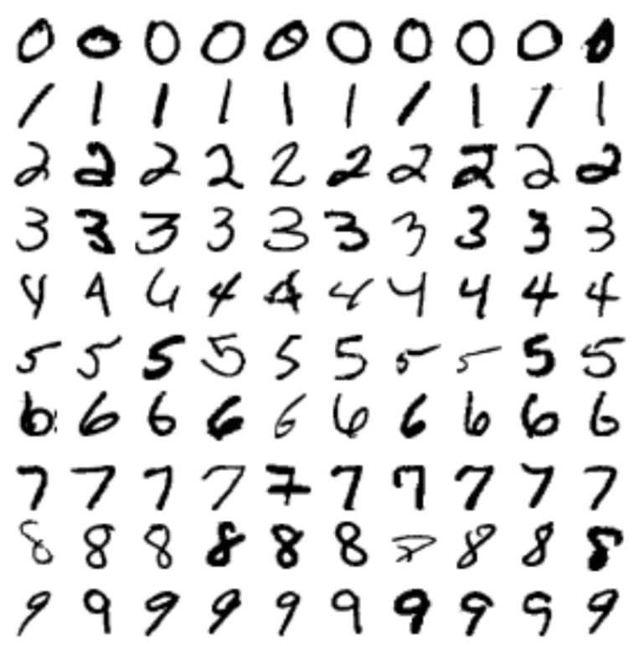
MNIST
  Large labelled data set of hand written digits.
  Easily loaded and utilized.
Notes:
Fits our criteria…apart from format

Slide 15
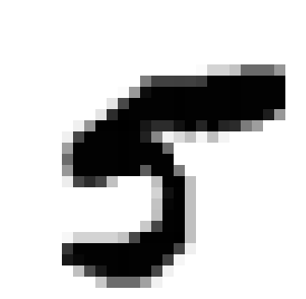
MNIST
  Each handwritten digit was originally fitted to a 28x28 pixel image. This image could then be represented in a 784 long array.
Digit array:
[0,0.00,0.00,0.00,0.00,0.00,0.00,0.00,0.00,0.00,0.00,0.00,0.00,0.00,0.00,0.00,0.00,0.00,0.00,0.00,0.00,0.00,0.00,0.00,0.00,0.00,0.00,0
0,0.00,0.00,0.00,0.00,0.00,0.00,0.00,0.00,0.00,0.00,0.00,0.00,0.00,0.00,0.00,0.00,0.00,0.00,0.00,0.00,0.00,0.00,0.00,0.00,0.00,0.00,0
0,0.00,0.00,0.00,0.00,0.00,0.00,0.00,0.00,0.00,0.00,0.00,0.00,0.00,0.00,0.00,0.00,0.00,0.00,0.00,0.00,0.00,0.00,0.00,0.00,0.00,0.00,0
0,0.00,0.00,0.00,0.00,0.00,0.00,0.00,0.00,0.00,0.00,0.00,0.00,0.00,0.00,0.00,0.00,0.00,0.00,0.00,0.00,0.00,0.00,0.00,0.00,0.00,0.00,0
0,0.00,0.00,0.00,0.00,0.00,0.00,0.00,0.00,0.00,0.00,0.00,0.00,0.00,0.00,0.00,0.00,0.00,0.00,0.00,0.00,0.00,0.00,0.00,0.00,0.00,0.00,0
0,0.00,0.00,0.00,0.00,0.00,0.00,0.00,0.00,0.00,0.00,0.00,0.00,0.00,0.00,0.00,0.00,0.00,0.00,0.00,0.00,0.00,0.00,0.00,0.00,0.00,0.00,0
0,0.00,0.00,0.00,0.00,0.00,0.00,0.00,0.00,0.00,0.00,0.00,0.00,0.00,0.00,0.00,0.00,0.00,0.02,0.17,0.17,0.24,0.58,0.58,0.58,0.41,0.00,0
0,0.00,0.00,0.00,0.00,0.00,0.00,0.00,0.00,0.00,0.00,0.00,0.00,0.51,0.75,0.75,0.75,0.75,0.76,0.99,0.99,0.99,0.99,0.99,0.99,0.99,0.00,0
0,0.00,0.00,0.00,0.00,0.00,0.00,0.00,0.00,0.00,0.00,0.02,0.40,0.95,0.99,0.99,0.99,0.99,0.99,0.99,0.99,0.99,0.99,0.99,0.99,0.99,0.00,0
0,0.00,0.00,0.00,0.00,0.00,0.00,0.00,0.00,0.00,0.11,0.72,0.99,0.99,0.99,0.99,0.99,0.99,0.99,0.99,0.99,0.99,0.99,0.99,0.99,0.99,0.00,0
0,0.00,0.00,0.00,0.00,0.00,0.00,0.00,0.00,0.11,0.83,0.99,0.99,0.99,0.99,0.99,0.99,0.99,0.99,0.99,0.99,0.99,0.99,0.99,0.89,0.40,0.00,0
0,0.00,0.00,0.00,0.00,0.00,0.00,0.06,0.41,0.99,0.99,1.00,0.99,0.91,0.83,0.83,0.93,0.99,0.85,0.99,0.85,0.83,0.51,0.38,0.00,0.00,0.00,0
0,0.00,0.00,0.00,0.00,0.00,0.06,0.73,0.99,0.99,0.99,0.99,0.99,0.87,0.47,0.05,0.15,0.25,0.04,0.25,0.04,0.00,0.00,0.00,0.00,0.00,0.00,0
0,0.00,0.00,0.00,0.00,0.00,0.38,0.99,0.99,0.99,0.99,0.99,0.99,0.99,0.99,0.58,0.00,0.00,0.00,0.00,0.00,0.00,0.00,0.00,0.00,0.00,0.00,0
0,0.00,0.00,0.00,0.00,0.00,0.58,0.99,0.99,0.99,0.99,0.99,0.99,0.99,0.99,0.99,0.00,0.00,0.00,0.00,0.00,0.00,0.00,0.00,0.00,0.00,0.00,0
0,0.00,0.00,0.00,0.00,0.00,0.41,0.99,0.99,0.99,0.99,0.99,0.99,0.64,0.99,0.99,0.52,0.00,0.00,0.00,0.00,0.00,0.00,0.00,0.00,0.00,0.00,0
0,0.00,0.00,0.00,0.00,0.00,0.07,0.73,0.83,0.73,0.24,0.00,0.00,0.00,0.25,0.99,1.00,0.25,0.00,0.00,0.00,0.00,0.00,0.00,0.00,0.00,0.00,0
0,0.00,0.00,0.00,0.00,0.00,0.00,0.00,0.00,0.00,0.00,0.00,0.00,0.00,0.17,0.94,0.99,0.25,0.00,0.00,0.00,0.00,0.00,0.00,0.00,0.00,0.00,0
0,0.00,0.00,0.00,0.00,0.00,0.00,0.00,0.00,0.00,0.00,0.00,0.00,0.00,0.23,0.98,0.99,0.25,0.00,0.00,0.00,0.00,0.00,0.00,0.00,0.00,0.00,0
0,0.00,0.00,0.00,0.00,0.00,0.00,0.00,0.00,0.00,0.00,0.00,0.00,0.00,0.25,0.25,0.99,0.99,0.25,0.00,0.00,0.00,0.00,0.00,0.00,0.00,0.00,0
0,0.00,0.00,0.00,0.00,0.00,0.00,0.00,0.00,0.00,0.00,0.00,0.00,0.00,0.21,0.21,0.73,0.99,0.99,0.25,0.00,0.00,0.00,0.00,0.00,0.00,0.00,0
0,0.00,0.00,0.00,0.00,0.00,0.00,0.00,0.03,0.17,0.17,0.17,0.17,0.24,0.72,0.99,0.99,0.99,1.00,0.25,0.00,0.00,0.00,0.00,0.00,0.00,0.00,0
0,0.00,0.00,0.00,0.00,0.00,0.00,0.00,0.79,0.99,0.99,0.99,0.99,0.99,0.99,0.99,0.99,0.99,0.73,0.06,0.00,0.00,0.00,0.00,0.00,0.00,0.00,0
0,0.00,0.00,0.00,0.00,0.00,0.00,0.00,0.91,0.97,0.99,0.99,0.99,0.99,0.99,0.99,0.99,0.75,0.04,0.00,0.00,0.00,0.00,0.00,0.00,0.00,0.00,0
0,0.00,0.00,0.00,0.00,0.00,0.00,0.00,0.00,0.25,0.71,0.91,0.99,0.99,0.99,0.99,0.72,0.05,0.00,0.00,0.00,0.00,0.00,0.00,0.00,0.00,0.00,0
0,0.00,0.00,0.00,0.00,0.00,0.00,0.00,0.00,0.00,0.00,0.22,0.58,0.58,0.58,0.37,0.05,0.00,0.00,0.00,0.00,0.00,0.00,0.00,0.00,0.00,0.00,0
0,0.00,0.00,0.00,0.00,0.00,0.00,0.00,0.00,0.00,0.00,0.00,0.00,0.00,0.00,0.00,0.00,0.00,0.00,0.00,0.00,0.00,0.00,0.00,0.00,0.00,0.00,0
0,0.00,0.00,0.00,0.00,0.00,0.00,0.00,0.00,0.00,0.00,0.00,0.00,0.00,0.00,0.00,0.00,0.00,0.00,0.00,0.00,0.00,0.00,0.00,0.00,0.00,0.00,0]

Slide 16
MNIST
  Each handwritten digit was originally fitted to a 28x28 pixel image. This image could then be represented in a 784 long array.
Digit array:
[0,0.00,0.00,0.00,0.00,0.00,0.00,0.00,0.00,0.00,0.00,0.00,0.00,0.00,0.00,0.00,0.00,0.00,0.00,0.00,0.00,0.00,0.00,0.00,0.00,0.00,0.00,0
0,0.00,0.00,0.00,0.00,0.00,0.00,0.00,0.00,0.00,0.00,0.00,0.00,0.00,0.00,0.00,0.00,0.00,0.00,0.00,0.00,0.00,0.00,0.00,0.00,0.00,0.00,0
0,0.00,0.00,0.00,0.00,0.00,0.00,0.00,0.00,0.00,0.00,0.00,0.00,0.00,0.00,0.00,0.00,0.00,0.00,0.00,0.00,0.00,0.00,0.00,0.00,0.00,0.00,0
0,0.00,0.00,0.00,0.00,0.00,0.00,0.00,0.00,0.00,0.00,0.00,0.00,0.00,0.00,0.00,0.00,0.00,0.00,0.00,0.00,0.00,0.00,0.00,0.00,0.00,0.00,0
0,0.00,0.00,0.00,0.00,0.00,0.00,0.00,0.00,0.00,0.00,0.00,0.00,0.00,0.00,0.00,0.00,0.00,0.00,0.00,0.00,0.00,0.00,0.00,0.00,0.00,0.00,0
0,0.00,0.00,0.00,0.00,0.00,0.00,0.00,0.00,0.00,0.00,0.00,0.00,0.00,0.00,0.00,0.00,0.00,0.00,0.00,0.00,0.00,0.00,0.00,0.00,0.00,0.00,0
0,0.00,0.00,0.00,0.00,0.00,0.00,0.00,0.00,0.00,0.00,0.00,0.00,0.00,0.00,0.00,0.00,0.00,0.02,0.17,0.17,0.24,0.58,0.58,0.58,0.41,0.00,0
0,0.00,0.00,0.00,0.00,0.00,0.00,0.00,0.00,0.00,0.00,0.00,0.00,0.51,0.75,0.75,0.75,0.75,0.76,0.99,0.99,0.99,0.99,0.99,0.99,0.99,0.00,0
0,0.00,0.00,0.00,0.00,0.00,0.00,0.00,0.00,0.00,0.00,0.02,0.40,0.95,0.99,0.99,0.99,0.99,0.99,0.99,0.99,0.99,0.99,0.99,0.99,0.99,0.00,0
0,0.00,0.00,0.00,0.00,0.00,0.00,0.00,0.00,0.00,0.11,0.72,0.99,0.99,0.99,0.99,0.99,0.99,0.99,0.99,0.99,0.99,0.99,0.99,0.99,0.99,0.00,0
0,0.00,0.00,0.00,0.00,0.00,0.00,0.00,0.00,0.11,0.83,0.99,0.99,0.99,0.99,0.99,0.99,0.99,0.99,0.99,0.99,0.99,0.99,0.99,0.89,0.40,0.00,0
0,0.00,0.00,0.00,0.00,0.00,0.00,0.06,0.41,0.99,0.99,1.00,0.99,0.91,0.83,0.83,0.93,0.99,0.85,0.99,0.85,0.83,0.51,0.38,0.00,0.00,0.00,0
0,0.00,0.00,0.00,0.00,0.00,0.06,0.73,0.99,0.99,0.99,0.99,0.99,0.87,0.47,0.05,0.15,0.25,0.04,0.25,0.04,0.00,0.00,0.00,0.00,0.00,0.00,0
0,0.00,0.00,0.00,0.00,0.00,0.38,0.99,0.99,0.99,0.99,0.99,0.99,0.99,0.99,0.58,0.00,0.00,0.00,0.00,0.00,0.00,0.00,0.00,0.00,0.00,0.00,0
0,0.00,0.00,0.00,0.00,0.00,0.58,0.99,0.99,0.99,0.99,0.99,0.99,0.99,0.99,0.99,0.00,0.00,0.00,0.00,0.00,0.00,0.00,0.00,0.00,0.00,0.00,0
0,0.00,0.00,0.00,0.00,0.00,0.41,0.99,0.99,0.99,0.99,0.99,0.99,0.64,0.99,0.99,0.52,0.00,0.00,0.00,0.00,0.00,0.00,0.00,0.00,0.00,0.00,0
0,0.00,0.00,0.00,0.00,0.00,0.07,0.73,0.83,0.73,0.24,0.00,0.00,0.00,0.25,0.99,1.00,0.25,0.00,0.00,0.00,0.00,0.00,0.00,0.00,0.00,0.00,0
0,0.00,0.00,0.00,0.00,0.00,0.00,0.00,0.00,0.00,0.00,0.00,0.00,0.00,0.17,0.94,0.99,0.25,0.00,0.00,0.00,0.00,0.00,0.00,0.00,0.00,0.00,0
0,0.00,0.00,0.00,0.00,0.00,0.00,0.00,0.00,0.00,0.00,0.00,0.00,0.00,0.23,0.98,0.99,0.25,0.00,0.00,0.00,0.00,0.00,0.00,0.00,0.00,0.00,0
0,0.00,0.00,0.00,0.00,0.00,0.00,0.00,0.00,0.00,0.00,0.00,0.00,0.00,0.25,0.25,0.99,0.99,0.25,0.00,0.00,0.00,0.00,0.00,0.00,0.00,0.00,0
0,0.00,0.00,0.00,0.00,0.00,0.00,0.00,0.00,0.00,0.00,0.00,0.00,0.00,0.21,0.21,0.73,0.99,0.99,0.25,0.00,0.00,0.00,0.00,0.00,0.00,0.00,0
0,0.00,0.00,0.00,0.00,0.00,0.00,0.00,0.03,0.17,0.17,0.17,0.17,0.24,0.72,0.99,0.99,0.99,1.00,0.25,0.00,0.00,0.00,0.00,0.00,0.00,0.00,0
0,0.00,0.00,0.00,0.00,0.00,0.00,0.00,0.79,0.99,0.99,0.99,0.99,0.99,0.99,0.99,0.99,0.99,0.73,0.06,0.00,0.00,0.00,0.00,0.00,0.00,0.00,0
0,0.00,0.00,0.00,0.00,0.00,0.00,0.00,0.91,0.97,0.99,0.99,0.99,0.99,0.99,0.99,0.99,0.75,0.04,0.00,0.00,0.00,0.00,0.00,0.00,0.00,0.00,0
0,0.00,0.00,0.00,0.00,0.00,0.00,0.00,0.00,0.25,0.71,0.91,0.99,0.99,0.99,0.99,0.72,0.05,0.00,0.00,0.00,0.00,0.00,0.00,0.00,0.00,0.00,0
0,0.00,0.00,0.00,0.00,0.00,0.00,0.00,0.00,0.00,0.00,0.22,0.58,0.58,0.58,0.37,0.05,0.00,0.00,0.00,0.00,0.00,0.00,0.00,0.00,0.00,0.00,0
0,0.00,0.00,0.00,0.00,0.00,0.00,0.00,0.00,0.00,0.00,0.00,0.00,0.00,0.00,0.00,0.00,0.00,0.00,0.00,0.00,0.00,0.00,0.00,0.00,0.00,0.00,0
0,0.00,0.00,0.00,0.00,0.00,0.00,0.00,0.00,0.00,0.00,0.00,0.00,0.00,0.00,0.00,0.00,0.00,0.00,0.00,0.00,0.00,0.00,0.00,0.00,0.00,0.00,0]

Slide 17
MNIST
  Each handwritten digit was originally fitted to a 28x28 pixel image. This image could then be represented in a 784 long array.
Digit array:
[0,0.00,0.00,0.00,0.00,0.00,0.00,0.00,0.00,0.00,0.00,0.00,0.00,0.00,0.00,0.00,0.00,0.00,0.00,0.00,0.00,0.00,0.00,0.00,0.00,0.00,0.00,0
0,0.00,0.00,0.00,0.00,0.00,0.00,0.00,0.00,0.00,0.00,0.00,0.00,0.00,0.00,0.00,0.00,0.00,0.00,0.00,0.00,0.00,0.00,0.00,0.00,0.00,0.00,0
0,0.00,0.00,0.00,0.00,0.00,0.00,0.00,0.00,0.00,0.00,0.00,0.00,0.00,0.00,0.00,0.00,0.00,0.00,0.00,0.00,0.00,0.00,0.00,0.00,0.00,0.00,0
0,0.00,0.00,0.00,0.00,0.00,0.00,0.00,0.00,0.00,0.00,0.00,0.00,0.00,0.00,0.00,0.00,0.00,0.00,0.00,0.00,0.00,0.00,0.00,0.00,0.00,0.00,0
0,0.00,0.00,0.00,0.00,0.00,0.00,0.00,0.00,0.00,0.00,0.00,0.00,0.00,0.00,0.00,0.00,0.00,0.00,0.00,0.00,0.00,0.00,0.00,0.00,0.00,0.00,0
0,0.00,0.00,0.00,0.00,0.00,0.00,0.00,0.00,0.00,0.00,0.00,0.00,0.00,0.00,0.00,0.00,0.00,0.00,0.00,0.00,0.00,0.00,0.00,0.00,0.00,0.00,0
0,0.00,0.00,0.00,0.00,0.00,0.00,0.00,0.00,0.00,0.00,0.00,0.00,0.00,0.00,0.00,0.00,0.00,0.02,0.17,0.17,0.24,0.58,0.58,0.58,0.41,0.00,0
0,0.00,0.00,0.00,0.00,0.00,0.00,0.00,0.00,0.00,0.00,0.00,0.00,0.51,0.75,0.75,0.75,0.75,0.76,0.99,0.99,0.99,0.99,0.99,0.99,0.99,0.00,0
0,0.00,0.00,0.00,0.00,0.00,0.00,0.00,0.00,0.00,0.00,0.02,0.40,0.95,0.99,0.99,0.99,0.99,0.99,0.99,0.99,0.99,0.99,0.99,0.99,0.99,0.00,0
0,0.00,0.00,0.00,0.00,0.00,0.00,0.00,0.00,0.00,0.11,0.72,0.99,0.99,0.99,0.99,0.99,0.99,0.99,0.99,0.99,0.99,0.99,0.99,0.99,0.99,0.00,0
0,0.00,0.00,0.00,0.00,0.00,0.00,0.00,0.00,0.11,0.83,0.99,0.99,0.99,0.99,0.99,0.99,0.99,0.99,0.99,0.99,0.99,0.99,0.99,0.89,0.40,0.00,0
0,0.00,0.00,0.00,0.00,0.00,0.00,0.06,0.41,0.99,0.99,1.00,0.99,0.91,0.83,0.83,0.93,0.99,0.85,0.99,0.85,0.83,0.51,0.38,0.00,0.00,0.00,0
0,0.00,0.00,0.00,0.00,0.00,0.06,0.73,0.99,0.99,0.99,0.99,0.99,0.87,0.47,0.05,0.15,0.25,0.04,0.25,0.04,0.00,0.00,0.00,0.00,0.00,0.00,0
0,0.00,0.00,0.00,0.00,0.00,0.38,0.99,0.99,0.99,0.99,0.99,0.99,0.99,0.99,0.58,0.00,0.00,0.00,0.00,0.00,0.00,0.00,0.00,0.00,0.00,0.00,0
0,0.00,0.00,0.00,0.00,0.00,0.58,0.99,0.99,0.99,0.99,0.99,0.99,0.99,0.99,0.99,0.00,0.00,0.00,0.00,0.00,0.00,0.00,0.00,0.00,0.00,0.00,0
0,0.00,0.00,0.00,0.00,0.00,0.41,0.99,0.99,0.99,0.99,0.99,0.99,0.64,0.99,0.99,0.52,0.00,0.00,0.00,0.00,0.00,0.00,0.00,0.00,0.00,0.00,0
0,0.00,0.00,0.00,0.00,0.00,0.07,0.73,0.83,0.73,0.24,0.00,0.00,0.00,0.25,0.99,1.00,0.25,0.00,0.00,0.00,0.00,0.00,0.00,0.00,0.00,0.00,0
0,0.00,0.00,0.00,0.00,0.00,0.00,0.00,0.00,0.00,0.00,0.00,0.00,0.00,0.17,0.94,0.99,0.25,0.00,0.00,0.00,0.00,0.00,0.00,0.00,0.00,0.00,0
0,0.00,0.00,0.00,0.00,0.00,0.00,0.00,0.00,0.00,0.00,0.00,0.00,0.00,0.23,0.98,0.99,0.25,0.00,0.00,0.00,0.00,0.00,0.00,0.00,0.00,0.00,0
0,0.00,0.00,0.00,0.00,0.00,0.00,0.00,0.00,0.00,0.00,0.00,0.00,0.00,0.25,0.25,0.99,0.99,0.25,0.00,0.00,0.00,0.00,0.00,0.00,0.00,0.00,0
0,0.00,0.00,0.00,0.00,0.00,0.00,0.00,0.00,0.00,0.00,0.00,0.00,0.00,0.21,0.21,0.73,0.99,0.99,0.25,0.00,0.00,0.00,0.00,0.00,0.00,0.00,0
0,0.00,0.00,0.00,0.00,0.00,0.00,0.00,0.03,0.17,0.17,0.17,0.17,0.24,0.72,0.99,0.99,0.99,1.00,0.25,0.00,0.00,0.00,0.00,0.00,0.00,0.00,0
0,0.00,0.00,0.00,0.00,0.00,0.00,0.00,0.79,0.99,0.99,0.99,0.99,0.99,0.99,0.99,0.99,0.99,0.73,0.06,0.00,0.00,0.00,0.00,0.00,0.00,0.00,0
0,0.00,0.00,0.00,0.00,0.00,0.00,0.00,0.91,0.97,0.99,0.99,0.99,0.99,0.99,0.99,0.99,0.75,0.04,0.00,0.00,0.00,0.00,0.00,0.00,0.00,0.00,0
0,0.00,0.00,0.00,0.00,0.00,0.00,0.00,0.00,0.25,0.71,0.91,0.99,0.99,0.99,0.99,0.72,0.05,0.00,0.00,0.00,0.00,0.00,0.00,0.00,0.00,0.00,0
0,0.00,0.00,0.00,0.00,0.00,0.00,0.00,0.00,0.00,0.00,0.22,0.58,0.58,0.58,0.37,0.05,0.00,0.00,0.00,0.00,0.00,0.00,0.00,0.00,0.00,0.00,0
0,0.00,0.00,0.00,0.00,0.00,0.00,0.00,0.00,0.00,0.00,0.00,0.00,0.00,0.00,0.00,0.00,0.00,0.00,0.00,0.00,0.00,0.00,0.00,0.00,0.00,0.00,0
0,0.00,0.00,0.00,0.00,0.00,0.00,0.00,0.00,0.00,0.00,0.00,0.00,0.00,0.00,0.00,0.00,0.00,0.00,0.00,0.00,0.00,0.00,0.00,0.00,0.00,0.00,0]

Slide 18
MNIST
  Each image was then manually labeled from 0 – 9. This label is represented as a ten item long array of nine 0’s and one 1. The position of the 1 indicates the digit;
    0 - [1, 0, 0, 0, 0, 0, 0, 0, 0, 0]
    1 - [0, 1, 0, 0, 0, 0, 0, 0, 0, 0]
    2 - [0, 0, 1, 0, 0, 0, 0, 0, 0, 0]
    3 - [0, 0, 0, 1, 0, 0, 0, 0, 0, 0]
    4 - [0, 0, 0, 0, 1, 0, 0, 0, 0, 0]
    5 - [0, 0, 0, 0, 0, 1, 0, 0, 0, 0]
    6 - [0, 0, 0, 0, 0, 0, 1, 0, 0, 0]
    7 - [0, 0, 0, 0, 0, 0, 0, 1, 0, 0]
    8 - [0, 0, 0, 0, 0, 0, 0, 0, 1, 0]
    9 - [0, 0, 0, 0, 0, 0, 0, 0, 0, 1]

Slide 19
MNIST
  Each image was then manually labeled from 0 – 9. This label is represented as a ten item long array of nine 0’s and one 1. The position of the 1 indicates the digit;
    0 - [1, 0, 0, 0, 0, 0, 0, 0, 0, 0]
    1 - [0, 1, 0, 0, 0, 0, 0, 0, 0, 0]
    2 - [0, 0, 1, 0, 0, 0, 0, 0, 0, 0]
    3 - [0, 0, 0, 1, 0, 0, 0, 0, 0, 0]
    4 - [0, 0, 0, 0, 1, 0, 0, 0, 0, 0]
    5 - [0, 0, 0, 0, 0, 1, 0, 0, 0, 0]
    6 - [0, 0, 0, 0, 0, 0, 1, 0, 0, 0]
    7 - [0, 0, 0, 0, 0, 0, 0, 1, 0, 0]
    8 - [0, 0, 0, 0, 0, 0, 0, 0, 1, 0]
    9 - [0, 0, 0, 0, 0, 0, 0, 0, 0, 1]

Slide 20
MNIST
  Each image was then manually labeled from 0 – 9. This label is represented as a ten item long array of nine 0’s and one 1. The position of the 1 indicates the digit;
    0 - [1, 0, 0, 0, 0, 0, 0, 0, 0, 0]
    1 - [0, 1, 0, 0, 0, 0, 0, 0, 0, 0]
    2 - [0, 0, 1, 0, 0, 0, 0, 0, 0, 0]
    3 - [0, 0, 0, 1, 0, 0, 0, 0, 0, 0]
    4 - [0, 0, 0, 0, 1, 0, 0, 0, 0, 0]
    5 - [0, 0, 0, 0, 0, 1, 0, 0, 0, 0]
    6 - [0, 0, 0, 0, 0, 0, 1, 0, 0, 0]
    7 - [0, 0, 0, 0, 0, 0, 0, 1, 0, 0]
    8 - [0, 0, 0, 0, 0, 0, 0, 0, 1, 0]
    9 - [0, 0, 0, 0, 0, 0, 0, 0, 0, 1]
    We shall see shortly why this label format is useful.

Slide 21
MNIST
Digit array:
[0,0.00,0.00,0.00,0.00,0.00,0.00,0.00,0.00,0.00,0.00,0.00,0.00,0.00,0.00,0.00,0.00,0.00,0.00,0.00,0.00,0.00,0.00,0.00,0.00,0.00,0.00,0
0,0.00,0.00,0.00,0.00,0.00,0.00,0.00,0.00,0.00,0.00,0.00,0.00,0.00,0.00,0.00,0.00,0.00,0.00,0.00,0.00,0.00,0.00,0.00,0.00,0.00,0.00,0
0,0.00,0.00,0.00,0.00,0.00,0.00,0.00,0.00,0.00,0.00,0.00,0.00,0.00,0.00,0.00,0.00,0.00,0.00,0.00,0.00,0.00,0.00,0.00,0.00,0.00,0.00,0
0,0.00,0.00,0.00,0.00,0.00,0.00,0.00,0.00,0.00,0.00,0.00,0.00,0.00,0.00,0.00,0.00,0.00,0.00,0.00,0.00,0.00,0.00,0.00,0.00,0.00,0.00,0
0,0.00,0.00,0.00,0.00,0.00,0.00,0.00,0.00,0.00,0.00,0.00,0.00,0.00,0.00,0.00,0.00,0.00,0.00,0.00,0.00,0.00,0.00,0.00,0.00,0.00,0.00,0
0,0.00,0.00,0.00,0.00,0.00,0.00,0.00,0.00,0.00,0.00,0.00,0.00,0.00,0.00,0.00,0.00,0.00,0.00,0.00,0.00,0.00,0.00,0.00,0.00,0.00,0.00,0
0,0.00,0.00,0.00,0.00,0.00,0.00,0.00,0.00,0.00,0.00,0.00,0.00,0.00,0.00,0.00,0.00,0.00,0.02,0.17,0.17,0.24,0.58,0.58,0.58,0.41,0.00,0
0,0.00,0.00,0.00,0.00,0.00,0.00,0.00,0.00,0.00,0.00,0.00,0.00,0.51,0.75,0.75,0.75,0.75,0.76,0.99,0.99,0.99,0.99,0.99,0.99,0.99,0.00,0
0,0.00,0.00,0.00,0.00,0.00,0.00,0.00,0.00,0.00,0.00,0.02,0.40,0.95,0.99,0.99,0.99,0.99,0.99,0.99,0.99,0.99,0.99,0.99,0.99,0.99,0.00,0
0,0.00,0.00,0.00,0.00,0.00,0.00,0.00,0.00,0.00,0.11,0.72,0.99,0.99,0.99,0.99,0.99,0.99,0.99,0.99,0.99,0.99,0.99,0.99,0.99,0.99,0.00,0
0,0.00,0.00,0.00,0.00,0.00,0.00,0.00,0.00,0.11,0.83,0.99,0.99,0.99,0.99,0.99,0.99,0.99,0.99,0.99,0.99,0.99,0.99,0.99,0.89,0.40,0.00,0
0,0.00,0.00,0.00,0.00,0.00,0.00,0.06,0.41,0.99,0.99,1.00,0.99,0.91,0.83,0.83,0.93,0.99,0.85,0.99,0.85,0.83,0.51,0.38,0.00,0.00,0.00,0
0,0.00,0.00,0.00,0.00,0.00,0.06,0.73,0.99,0.99,0.99,0.99,0.99,0.87,0.47,0.05,0.15,0.25,0.04,0.25,0.04,0.00,0.00,0.00,0.00,0.00,0.00,0
0,0.00,0.00,0.00,0.00,0.00,0.38,0.99,0.99,0.99,0.99,0.99,0.99,0.99,0.99,0.58,0.00,0.00,0.00,0.00,0.00,0.00,0.00,0.00,0.00,0.00,0.00,0
0,0.00,0.00,0.00,0.00,0.00,0.58,0.99,0.99,0.99,0.99,0.99,0.99,0.99,0.99,0.99,0.00,0.00,0.00,0.00,0.00,0.00,0.00,0.00,0.00,0.00,0.00,0
0,0.00,0.00,0.00,0.00,0.00,0.41,0.99,0.99,0.99,0.99,0.99,0.99,0.64,0.99,0.99,0.52,0.00,0.00,0.00,0.00,0.00,0.00,0.00,0.00,0.00,0.00,0
0,0.00,0.00,0.00,0.00,0.00,0.07,0.73,0.83,0.73,0.24,0.00,0.00,0.00,0.25,0.99,1.00,0.25,0.00,0.00,0.00,0.00,0.00,0.00,0.00,0.00,0.00,0
0,0.00,0.00,0.00,0.00,0.00,0.00,0.00,0.00,0.00,0.00,0.00,0.00,0.00,0.17,0.94,0.99,0.25,0.00,0.00,0.00,0.00,0.00,0.00,0.00,0.00,0.00,0
0,0.00,0.00,0.00,0.00,0.00,0.00,0.00,0.00,0.00,0.00,0.00,0.00,0.00,0.23,0.98,0.99,0.25,0.00,0.00,0.00,0.00,0.00,0.00,0.00,0.00,0.00,0
0,0.00,0.00,0.00,0.00,0.00,0.00,0.00,0.00,0.00,0.00,0.00,0.00,0.00,0.25,0.25,0.99,0.99,0.25,0.00,0.00,0.00,0.00,0.00,0.00,0.00,0.00,0
0,0.00,0.00,0.00,0.00,0.00,0.00,0.00,0.00,0.00,0.00,0.00,0.00,0.00,0.21,0.21,0.73,0.99,0.99,0.25,0.00,0.00,0.00,0.00,0.00,0.00,0.00,0
0,0.00,0.00,0.00,0.00,0.00,0.00,0.00,0.03,0.17,0.17,0.17,0.17,0.24,0.72,0.99,0.99,0.99,1.00,0.25,0.00,0.00,0.00,0.00,0.00,0.00,0.00,0
0,0.00,0.00,0.00,0.00,0.00,0.00,0.00,0.79,0.99,0.99,0.99,0.99,0.99,0.99,0.99,0.99,0.99,0.73,0.06,0.00,0.00,0.00,0.00,0.00,0.00,0.00,0
0,0.00,0.00,0.00,0.00,0.00,0.00,0.00,0.91,0.97,0.99,0.99,0.99,0.99,0.99,0.99,0.99,0.75,0.04,0.00,0.00,0.00,0.00,0.00,0.00,0.00,0.00,0
0,0.00,0.00,0.00,0.00,0.00,0.00,0.00,0.00,0.25,0.71,0.91,0.99,0.99,0.99,0.99,0.72,0.05,0.00,0.00,0.00,0.00,0.00,0.00,0.00,0.00,0.00,0
0,0.00,0.00,0.00,0.00,0.00,0.00,0.00,0.00,0.00,0.00,0.22,0.58,0.58,0.58,0.37,0.05,0.00,0.00,0.00,0.00,0.00,0.00,0.00,0.00,0.00,0.00,0
0,0.00,0.00,0.00,0.00,0.00,0.00,0.00,0.00,0.00,0.00,0.00,0.00,0.00,0.00,0.00,0.00,0.00,0.00,0.00,0.00,0.00,0.00,0.00,0.00,0.00,0.00,0
0,0.00,0.00,0.00,0.00,0.00,0.00,0.00,0.00,0.00,0.00,0.00,0.00,0.00,0.00,0.00,0.00,0.00,0.00,0.00,0.00,0.00,0.00,0.00,0.00,0.00,0.00,0]
Label array:
[ 0.0, 0.00, 0.00, 0.00, 0.00, 1.00, 0.00, 0.00, 0.00, 0.00]
Notes:
From here switch to using the code

Slide 22
MNIST
  Turning real-world data into a form usable by algorithms is an important part of Machine Learning.
  This is called data preprocessing.
  MNIST dataset has already had all this done for us, so is a good place to start for us beginners.
Notes:
From here switch to using the code

Slide 23
The fun stuff.
Tutorial code can be found in the following repository: https://github.com/CapgeminiTechHub/Tensorflow/tree/master/MNIST%20Tutorials

Slide 24
Run ‘mnist_tutorial_data.py’
Code to import the data.
Lines 1-42
And to visualize the data.
Lines 43-123

Slide 25
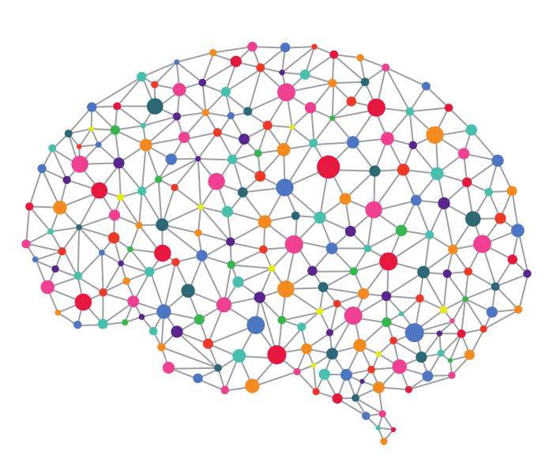
Artificial Neural Networks
An area of AI/Machine learning inspired by natural intelligence.
ANNs are at their heart a mathematical model of a biological neural network.
Notes:
Note: not “model of brain”, we are a far way off that and this is still fairly simplistic.
The mathematical model, and our understanding of the biological neural network have diverged considerably in someways since the first beginners, but there are still overlaps.

Slide 26
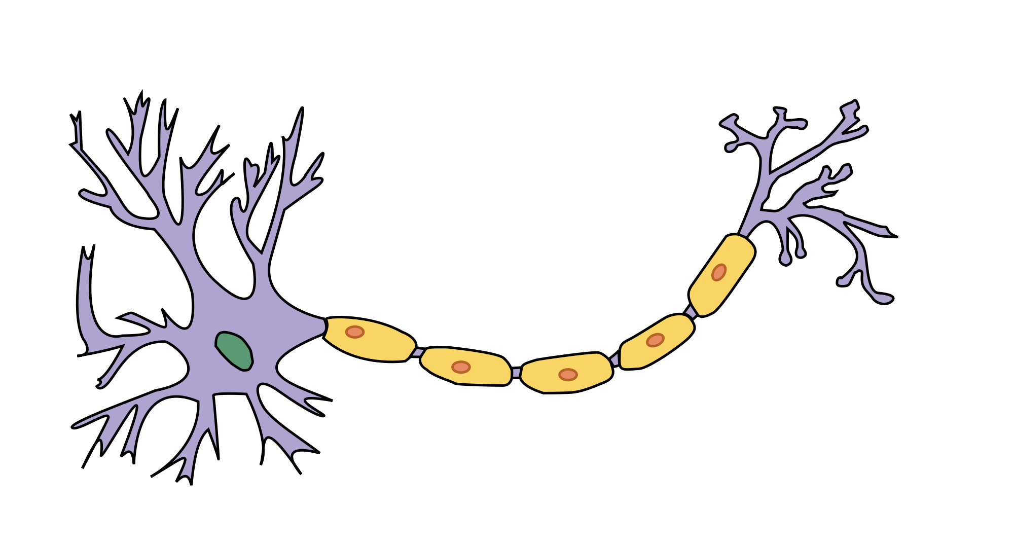
Biological Neuron
A single cell.
Uses chemical gradients to send an ‘Action Potential’, i.e. a signal, down its stem.
All or Nothing: it will only fire it receives enough stimulus to do so, otherwise it is inactive.

Slide 27
Biological Neural Network
A network of Neurons.
A signal is propagated through the network using neurotransmitters.
Key points: A feed-forward network of discreet On/Off units.
NT
NT
NT
NT
NT
NT
Notes:
Feed-forward: the state of one unit is dependent on the state of the ones before it.

Slide 28
Artificial Neuron - Perceptron
A Neuron can be very simply represented by a mathematical function, that will only fire (produce an output between 0-1) if the total input exceeds a threshold.
This function is often called the Step Function or Activation function.
S
Input
Input
Output (0-1)
Input

Slide 29
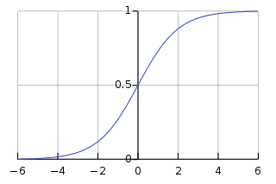
Artificial Neuron - Perceptron
A Neuron can be very simply represented by a mathematical function, that will only fire (produce an output between 0-1) if the total input exceeds a threshold.
This function is often called the Step Function or Activation function.
We will be using a function called the Sigmoid function.
Input
Input
Output (0-1)
Input
Notes:
The graph shows an example activation function, the Sigmoid function.
See how no matter what the input, the output is between 0-1
Now lets create a network.

Slide 30
Artificial Neuron - Perceptron
There is a concept in ANN’s called the bias.
It can be thought of as a ‘threshold’ – it makes certain perceptrons harder to fire than others.
Input
Input
Output (0-1)
Bias

Slide 31
Artificial Neuron - Perceptron
There is a concept in ANN’s called the bias.
It can be thought of as a ‘threshold’ – it makes certain perceptrons harder to fire than others.
However in this tutorial we don’t actually need them, so for simplicity’s sake we will forget about it for now.
Input
Input
Output (0-1)
Bias
Notes:
The bias is very important in ANNs
But for our purposes would make it unnecessarily complex – we can get decent accuracy without them.
Bias’s can be seen as additional weights, so they’re not really anything new or different. But to explain that I’d need to get more complex, just to bring us back to our current understanding.

Slide 32
Artificial Neuron - Perceptron
So let’s use these to make a network.
Input
Input
Output (0-1)
Input
Notes:
Now lets create a network.

Slide 33
Artificial Neural Networks
We can now create a network of these individual perceptrons to form an Artificial Neural Network.
Each arrow represents the output of the left Perceptron being piped to the next Perceptron as one of its inputs.
S
S
In
S
S
Output
S
S
In
S
S
Output
S
S
In
S
S
Output
S
S
In
S
S
Output
S
S
In
S
S
Output
S
S

Slide 34
Artificial Neural Networks
We can now form a network of these individual perceptrons to form an Artificial Neural Network.
Each arrow represents the output of the left Perceptron being piped to the next Perceptron as one of its inputs.
These connections are weighted, so some Perceptron to Perceptron links are more important then others.
S
S
In
S
S
Output
S
S
In
S
S
Output
S
S
In
S
S
Output
S
S
In
S
S
Output
S
S
In
S
S
Output
S
S
Notes:
These weightings are what changes during the learning process.
The changing weights allow a single generic network, to transform into multiple, specific, networks.

Slide 35
Artificial Neural Networks
These connections are weighted, so some Perceptron to Perceptron links are more important then others.
It is these weights which are altered during the training process, so the model goes from a generic network, to one that is specific for our use-case.
S
S
In
S
S
Output
S
S
In
S
S
Output
S
S
In
S
S
Output
S
S
In
S
S
Output
S
S
In
S
S
Output
S
S
Notes:
These weightings are what changes during the learning process.
The changing weights allow a single generic network, to transform into multiple, specific, networks.
----------
So this is a basic network, but how exactly does this work?
You can think of it as one pattern of inputs, causes a certain in the first layer, that causes another pattern in the next

Slide 36
Artificial Neural Networks
S
S
How it works:
A certain pattern of inputs, causes a pattern in the first layer.
S
S
In
Output
S
S
In
S
S
Output
S
S
In
S
S
Output
S
S
In
S
S
Output
S
S
In
S
S
Output
S
S
Notes:
You can think of it as one pattern of inputs, causes a certain pattern in the first layer

Slide 37
Artificial Neural Networks
S
S
How it works:
A certain pattern of inputs, causes a pattern in the first layer.
That propagates forward and creates a pattern in the next layer
S
S
In
Output
S
S
In
S
S
Output
S
S
In
S
S
Output
S
S
In
S
S
Output
S
S
In
S
S
Output
S
S
Notes:
that causes another pattern in the next

Slide 38
Artificial Neural Networks
S
S
How it works:
A certain pattern of inputs, causes a pattern in the first layer.
That propagates forward and creates a pattern in the next layer.
And so on…
S
S
In
Output
S
S
In
S
S
Output
S
S
In
S
S
Output
S
S
In
S
S
Output
S
S
In
S
S
Output
S
S
Notes:
And so on

Slide 39
Artificial Neural Networks
S
S
How it works:
A certain pattern of inputs, causes a pattern in the first layer.
That propagates forward and creates a pattern in the next layer.
And so on, until an output is generated.
S
S
In
Output
S
S
In
S
S
Output
S
S
In
S
S
Output
S
S
In
S
S
Output
S
S
In
S
S
Output
S
S
Notes:
Until an out put is decided
Note: This is for a classification problem. For more complex problems the perceptrons aren’t simply on/off but instead the numerical value between 0 and 1 is important.

Slide 40
Artificial Neural Networks
S
S
In
S
S
Output
S
S
In
S
S
Output
A different input pattern, will result in a different output.
S
S
In
S
S
Output
S
S
In
S
S
Output
S
S
In
S
S
Output
S
S
Notes:
A different input pattern will result in a different output

Slide 41
Artificial Neural Networks
S
S
In
S
S
Output
S
S
In
S
S
Output
A different input pattern, will result in a different output.
S
S
In
S
S
Output
S
S
In
S
S
Output
S
S
In
S
S
Output
S
S
Notes:
A different input pattern will result in a different output

Slide 42
Artificial Neural Networks
S
S
In
S
S
Output
S
S
In
S
S
Output
A different input pattern, will result in a different output.
S
S
In
S
S
Output
S
S
In
S
S
Output
S
S
In
S
S
Output
S
S
Notes:
A different input pattern will result in a different output

Slide 43
Artificial Neural Networks
S
S
In
S
S
Output
S
S
In
S
S
Output
A different input pattern, will result in a different output.
S
S
In
S
S
Output
S
S
In
S
S
Output
S
S
In
S
S
Output
S
S
Notes:
A different input pattern will result in a different output
______________
This network however is more complicated then we need…

Slide 44
Artificial Neural Networks
The variables that define the model (number of hidden layers, nodes in each layer, starting weight and bias values, e.t.c) are called hyperparameters.
Often your first attempt at a model does not work as well as expected, and these hyperparameters need to be tuned to create a good architecture.
S
S
In
S
S
Output
S
S
In
S
S
Output
S
S
In
S
S
Output
S
S
In
S
S
Output
S
S
In
S
S
Output
S
S

Slide 45
MNIST Network
S
Output
S
Output
We can actually use a fairly simple network to train on the MNIST dataset.
We only need a single layer of 10 perceptrons to create a predictive model.
These perceptrons use a particular type of activation function called the Sigmoid Function
In₁
S
Output
S
Output
In₁
S
Output
In₃
S
Output
.
.
.
S
Output
Output
S
Output
In₇₈₄
S
Output
Input
S
Output
Notes:
Note: the 784 inputs are the pixels of the 28x28 picture in array form, as we saw earlier on.

Slide 46

MNIST Network
S₀
Output
S₁
Output
In₁
S₂
Output
This single Sigmoid layer gives 10 outputs between 0 and 1.
S₃
Output
In₁
S₄
Output
In₃
S₅
Output
.
.
.
S₆
Output
S₇
Output
In₇₈₄
S₈
Output
S₉
Output
INPUTS
WEIGHTS
Sigmoid
Perceptrons
OUTPUT

Slide 47
MNIST Network
S₀
P(0)
S₁
P(1)
In₁
S₂
P(2)
This single Sigmoid layer gives 10 outputs between 0 and 1.
Each output can be interpreted as a probability, with 1 being the highest (100% certainty that it is that digit).
So in this example P(5) should be the highest output.
S₃
P(3)
In₁
S₄
P(4)
In₃
S₅
P(5)
.
.
.
S₆
P(6)
S₇
P(7)
In₇₈₄
S₈
P(8)
S₉
P(9)
INPUTS
WEIGHTS
Sigmoid
Perceptrons
OUTPUT

Slide 48
MNIST Network
S₀
0.01
S₁
0.15
In₁
S₂
0.20
This single Sigmoid layer gives 10 outputs between 0 and 1.
Each output can be interpreted as a probability, with 1 being the highest (100% certainty that it is that digit).
So in this example P(5) should be the highest output.
S₃
0.29
In₁
S₄
0.12
In₃
S₅
0.81
.
.
.
S₆
0.72
S₇
0.35
In₇₈₄
S₈
0.41
S₉
0.33
INPUTS
WEIGHTS
Sigmoid
Perceptrons
OUTPUT

Slide 49
MNIST Network
S₀
0.01
0
S₁
0.15
0
In₁
S₂
0.20
0
S₃
0.29
0
In₁
We can see now why the label format is so useful.
It allows direct comparison between the model output and the label.
S₄
0.12
0
In₃
S₅
0.81
1
.
.
.
S₆
0.72
0
S₇
0.35
0
In₇₈₄
S₈
0
0.41
S₉
0.33
0
INPUTS
WEIGHTS
Sigmoid
Perceptrons
OUTPUT
LABEL
Notes:
We saw earlier how we can see how a multilayer network would allow different output with different inputs, but how does this one work?

Slide 50
Open ‘mnist_tutorial_model.py’
Coding the model.
Lines 124-146
Running the model.
Lines 147-166

Slide 51
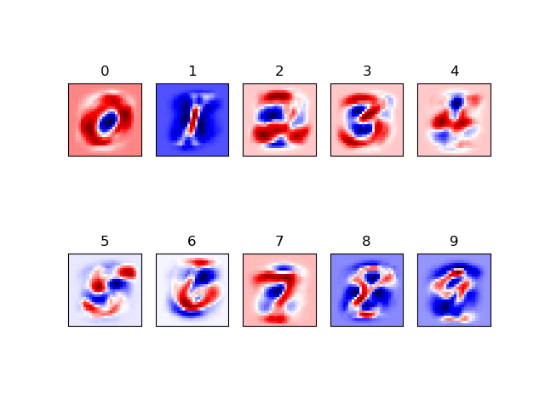
MNIST Network
Visualising Weights
S₀
P(0)
S₁
P(1)
In₁
S₂
P(2)
S₃
P(3)
In₁
S₄
P(4)
In₃
S₅
P(5)
.
.
.
S₆
P(6)
S₇
P(7)
In₇₈₄
S₈
P(8)
S₉
P(9)

Slide 52
MNIST Network
How it works
S₀
P(0)
S₁
P(1)
S₂
P(2)
S₃
P(3)
S₄
P(4)
Each Pixel will map to each Sigmoid Perceptron.
This diagram shows just three pixels’ mappings.
S₅
P(5)
S₆
P(6)
S₇
P(7)
S₈
P(8)
S₉
P(9)

Slide 53
MNIST Network
How it works
S₀
P(0)
S₁
P(1)
S₂
P(2)
S₃
P(3)
S₄
P(4)
We can further simplify this down to show the three pixels just mapping with the Sigmoid Perceptron representing the probability the image is a 5.
S₅
P(5)
S₆
P(6)
S₇
P(7)
S₈
P(8)
S₉
P(9)

Slide 54
MNIST Network
How it works
S₀
P(0)
S₁
P(1)
S₂
P(2)
S₃
P(3)
S₄
P(4)
S₅
P(5)
Lets looks at how each of these links should behave.
S₆
P(6)
S₇
P(7)
S₈
P(8)
S₉
P(9)

Slide 55
MNIST Network
How it works
S₀
P(0)
S₁
P(1)
S₂
P(2)
S₃
P(3)
S₄
P(4)
If this pixel is dark, it suggests the image is a 5.
So the weighting should be positive, to push the sigmoid function towards 1.
S₅
P(5)
S₆
P(6)
S₇
P(7)
S₈
P(8)
S₉
P(9)

Slide 56
MNIST Network
How it works
S₀
P(0)
S₁
P(1)
S₂
P(2)
S₃
P(3)
S₄
P(4)
If this pixel is dark, it suggests the image is not a 5.
So the weighting should be negative, to push the sigmoid function towards 0.
S₅
P(5)
S₆
P(6)
S₇
P(7)
S₈
P(8)
S₉
P(9)

Slide 57
MNIST Network
How it works
S₀
P(0)
S₁
P(1)
S₂
P(2)
S₃
P(3)
S₄
P(4)
This pixel is very dependant on how you draw the 5.
So it’s value shouldn’t really have too much impact one way or another, so the weighting of this link should be small.
S₅
P(5)
S₆
P(6)
S₇
P(7)
S₈
P(8)
S₉
P(9)
Notes:
By small I mean around 0 – neither strongly positive nor negative.

Slide 58
MNIST Network
How it works
S₀
P(0)
S₁
P(1)
S₂
P(2)
S₃
P(3)
S₄
P(4)
S₅
P(5)
S₆
P(6)
S₇
P(7)
S₈
P(8)
S₉
P(9)
Notes:
By small I mean around 0 – neither strongly positive nor negative.

Slide 59
Run ‘mnist_tutorial_model.py’
Visualising the weights.
Lines 167-184

Slide 60
So we’ve created the base model.
But now we need to get it to learn.

Slide 61
Error/Cost Functions
In order to learn a model needs to know if it is wrong.
The learning process is better if a model can work out how wrong it is, and in which direction it is wrong.

Slide 62
Error/Cost Functions
In order to learn a model needs to know if it is wrong.
The learning process is better if a model can work out how wrong it is, and in which direction it is wrong.
For example, which is better?
Am I in the right place? - NO!
Or
Am I in the right place? – you are 200 metres northwest of the target.
Ensuring the Error function (often called the Cost function) provides suitable information, allows for efficient training.

Slide 63
Error/Cost Functions
In order to learn a model needs to know if it is wrong.
The learning process is better if a model can work out how wrong it is, and in which direction it is wrong.
For example, which is better?
Am I in the right place? - NO!
Or
Am I in the right place? – you are 200 metres Northwest of the target.
Ensuring the Error function (often called the Cost function) provides suitable information, allows for efficient training.
Other terms for error include ‘loss’ and ‘objective function’.
All are basically the same but tend to be used indifferent scenarios, with ‘loss’ being for a single data point, where as ‘objective function’ is a general term for any function that you optimize during training.

Slide 64
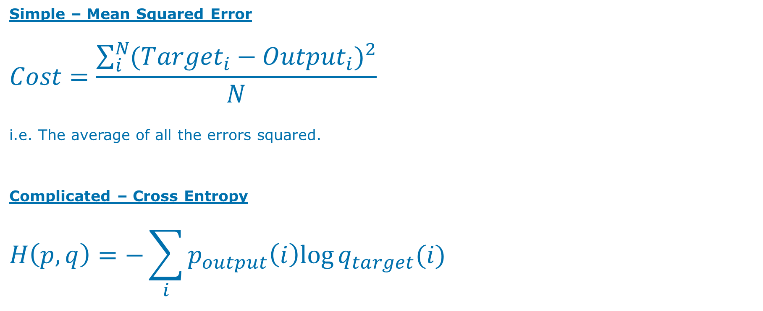
Error/Cost Functions
Simple – Mean Squared Error
$$Cost=\frac{\sum_{i}^{N}{({{Target}_{i}−{Output}_{i})}^{2}}}{N}$$
i.e. The average of all the errors squared.
Complicated – Cross Entropy
$$H\left(p,q\right)=−\sum_{i}{p_{output}\left(i\right)log⁡q_{target}(i)}$$

Slide 65
Learning Algorithms
The learning algorithm is the process of taking the cost, and using it to make changes to the weights and thresholds of the model.
i.e. in the above example we would start walking southeast for 200 metres.
One of the most common family of learning algorithms is Gradient Descent.

Slide 66

Gradient Descent
Lets take a simple example with the MSE cost function: $Cost=\frac{\sum_{i}^{N}{({{Target}_{i}−{Output}_{i})}^{2}}}{N}$
Target | Output | (Target-Output) | Cost
3 | 0
3 | 1
3 | 2
3 | 3
3 | 4
3 | 5
3 | 6

Slide 67
Gradient Descent
Lets take a simple example with the MSE cost function: $Cost=\frac{\sum_{i}^{N}{({{Target}_{i}−{Output}_{i})}^{2}}}{N}$
Target | Output | (Target-Output) | Cost
3 | 0
3 | 1
3 | 2
3 | 3 | 0 | 0
3 | 4
3 | 5
3 | 6

Slide 68
Gradient Descent
Lets take a simple example with the MSE cost function: $Cost=\frac{\sum_{i}^{N}{({{Target}_{i}−{Output}_{i})}^{2}}}{N}$
Target | Output | (Target-Output) | Cost
3 | 0
3 | 1 | 2 | 4
3 | 2
3 | 3 | 0 | 0
3 | 4
3 | 5 | -2 | 4
3 | 6

Slide 69
Gradient Descent
Lets take a simple example with the MSE cost function: $Cost=\frac{\sum_{i}^{N}{({{Target}_{i}−{Output}_{i})}^{2}}}{N}$
Target | Output | (Target-Output) | Cost
3 | 0 | 3 | 9
3 | 1 | 2 | 4
3 | 2 | 1 | 1
3 | 3 | 0 | 0
3 | 4 | -1 | 1
3 | 5 | -2 | 4
3 | 6 | -3 | 9

Slide 70
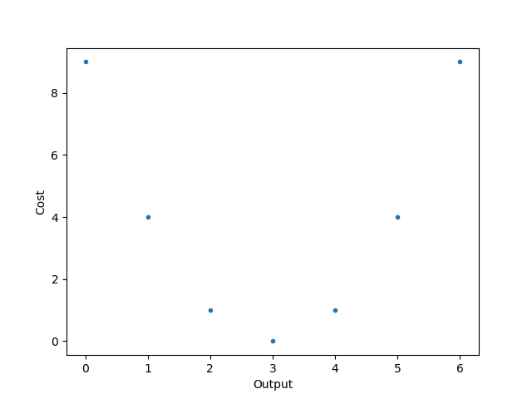
Gradient Descent
Lets take a simple example with the MSE cost function: $Cost=\frac{\sum_{i}^{N}{({{Target}_{i}−{Output}_{i})}^{2}}}{N}$
Target | Output | Diff (T-O) | Cost
3 | 0 | 3 | 9
3 | 1 | 2 | 4
3 | 2 | 1 | 1
3 | 3 | 0 | 0
3 | 4 | -1 | 1
3 | 5 | -2 | 4
3 | 6 | -3 | 9

Slide 71
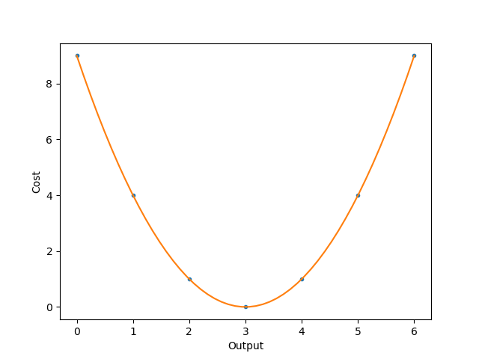
Gradient Descent
Lets take a simple example with the MSE cost function: $Cost=\frac{\sum_{i}^{N}{({{Target}_{i}−{Output}_{i})}^{2}}}{N}$
Target | Output | Diff (T-O) | Cost
3 | 0 | 3 | 9
3 | 1 | 2 | 4
3 | 2 | 1 | 1
3 | 3 | 0 | 0
3 | 4 | -1 | 1
3 | 5 | -2 | 4
3 | 6 | -3 | 9

Slide 72
Gradient Descent
Lets take a simple example with the MSE cost function: $Cost=\frac{\sum_{i}^{N}{({{Target}_{i}−{Output}_{i})}^{2}}}{N}$
Target | Output | Diff (T-O) | Cost
3 | 0 | 3 | 9
3 | 1 | 2 | 4
3 | 2 | 1 | 1
3 | 3 | 0 | 0
3 | 4 | -1 | 1
3 | 5 | -2 | 4
3 | 6 | -3 | 9

Slide 73
Gradient Descent
Lets take a simple example with the MSE cost function: $Cost=\frac{\sum_{i}^{N}{({{Target}_{i}−{Output}_{i})}^{2}}}{N}$
Target | Output | Diff (T-O) | Cost
3 | 0 | 3 | 9
3 | 1 | 2 | 4
3 | 2 | 1 | 1
3 | 3 | 0 | 0
3 | 4 | -1 | 1
3 | 5 | -2 | 4
3 | 6 | -3 | 9

Slide 74
Gradient Descent
Lets take a simple example with the MSE cost function: $Cost=\frac{\sum_{i}^{N}{({{Target}_{i}−{Output}_{i})}^{2}}}{N}$
Target | Output | Diff (T-O) | Cost
3 | 0 | 3 | 9
3 | 1 | 2 | 4
3 | 2 | 1 | 1
3 | 3 | 0 | 0
3 | 4 | -1 | 1
3 | 5 | -2 | 4
3 | 6 | -3 | 9

Slide 75
Gradient Descent
Lets take a simple example with the MSE cost function: $Cost=\frac{\sum_{i}^{N}{({{Target}_{i}−{Output}_{i})}^{2}}}{N}$
Target | Output | Diff (T-O) | Cost
3 | 0 | 3 | 9
3 | 1 | 2 | 4
3 | 2 | 1 | 1
3 | 3 | 0 | 0
3 | 4 | -1 | 1
3 | 5 | -2 | 4
3 | 6 | -3 | 9

Slide 76
Gradient Descent
Lets take a simple example with the MSE cost function: $Cost=\frac{\sum_{i}^{N}{({{Target}_{i}−{Output}_{i})}^{2}}}{N}$
Target | Output | Diff (T-O) | Cost
3 | 0 | 3 | 9
3 | 1 | 2 | 4
3 | 2 | 1 | 1
3 | 3 | 0 | 0
3 | 4 | -1 | 1
3 | 5 | -2 | 4
3 | 6 | -3 | 9

Slide 77
Gradient Descent
Lets take a simple example with the MSE cost function: $Cost=\frac{\sum_{i}^{N}{({{Target}_{i}−{Output}_{i})}^{2}}}{N}$
Target | Output | Diff (T-O) | Cost
3 | 0 | 3 | 9
3 | 1 | 2 | 4
3 | 2 | 1 | 1
3 | 3 | 0 | 0
3 | 4 | -1 | 1
3 | 5 | -2 | 4
3 | 6 | -3 | 9
Oh no!

Slide 78
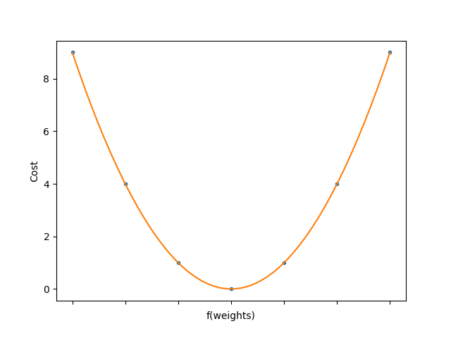
Gradient Descent
Lets take a simple example with the MSE cost function: $Cost=\frac{\sum_{i}^{N}{({{Target}_{i}−{Output}_{i})}^{2}}}{N}$
Target | Output | Diff (T-O) | Cost
3 | 0 | 3 | 9
3 | 1 | 2 | 4
3 | 2 | 1 | 1
3 | 3 | 0 | 0
3 | 4 | -1 | 1
3 | 5 | -2 | 4
3 | 6 | -3 | 9
Output = f(weights)

Slide 79
Run ‘mnist_tutorial_training.py’
Coding the cost and learning algorithm.
Lines 189-226
Training the model.
Lines 227-252

Slide 80
Run ‘mnist_tutorial_testing.py’
Testing the model.
Lines 255-280

Slide 81
Opening the Black Box
Artificial Neural Networks are sometimes described as ‘Black Boxes’ i.e. we can’t see or understand their inner workings.
Overcoming this problem is one of the main frontiers for ANN research.
However for a simple network like this, we can easily visualise the weights, and thus try to understand the inner workings of the network.

Slide 82
MNIST Network
S₀
P(0)
S₁
P(1)
In₁
S₂
P(2)
S₃
P(3)
In₁
S₄
P(4)
In₃
S₅
P(5)
.
.
.
S₆
P(6)
S₇
P(7)
In₇₈₄
S₈
P(8)
S₉
P(9)
INPUTS
WEIGHTS
Sigmoid
Perceptrons
OUTPUT

Slide 83
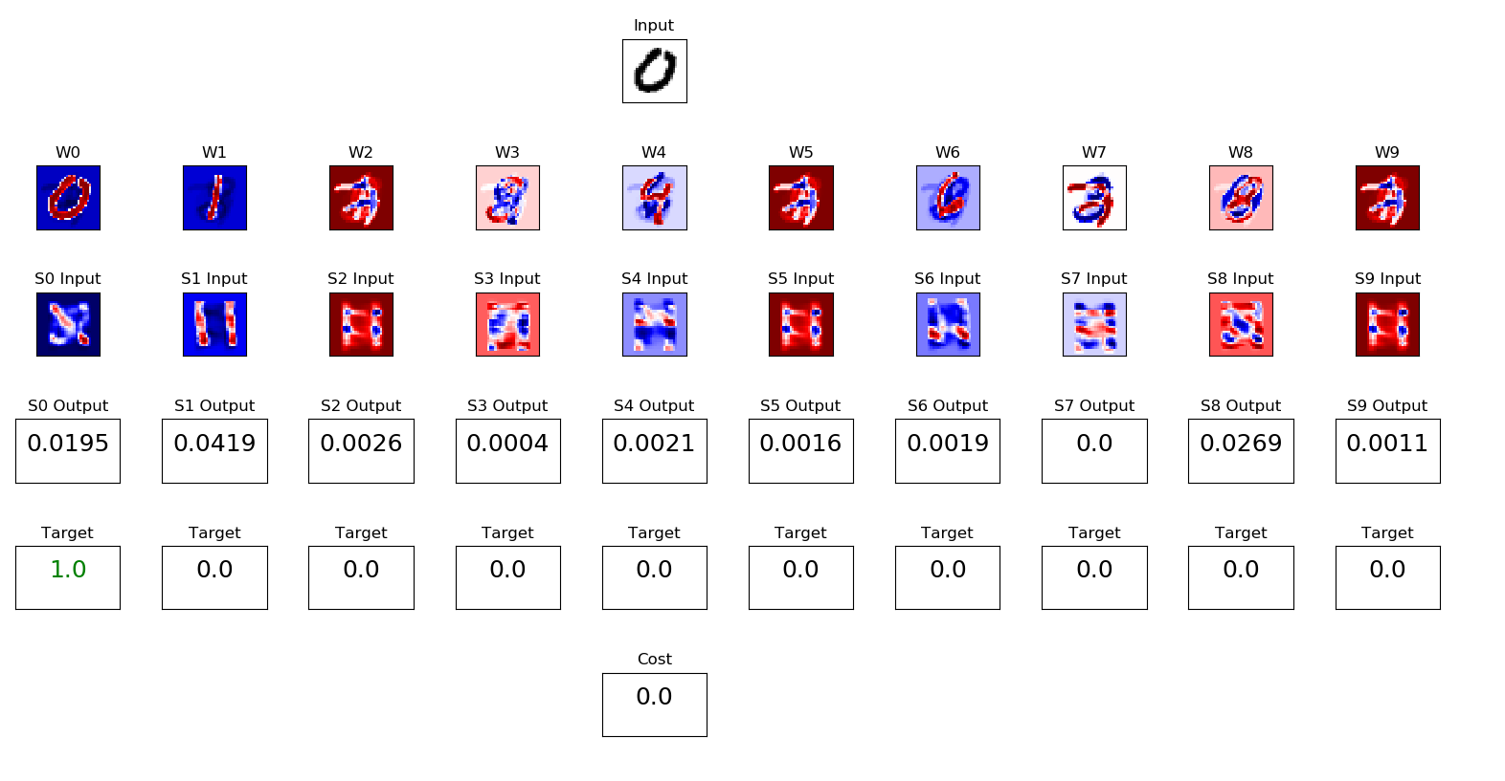
MNIST Network
In₁
In₁
In₃
.
.
.
In₇₈₄
INPUTS

Slide 84
MNIST Network – Weight Visualisation
S₀
P(0)
S₁
P(1)
In₁
S₂
P(2)
S₃
P(3)
In₁
S₄
P(4)
In₃
S₅
P(5)
.
.
.
S₆
P(6)
S₇
P(7)
In₇₈₄
S₈
P(8)
S₉
P(9)

Slide 85
MNIST Network – Network Visualisation
S₀
S₁
In₁
S₂
S₃
In₁
S₄
In₃
S₅
.
.
.
S₆
S₇
In₇₈₄
S₈
S₉

Slide 86
MNIST Network – Network Visualisation
S₀
P(0)
S₁
P(1)
S₂
P(2)
S₃
P(3)
S₄
P(4)
S₅
P(5)
S₆
P(6)
S₇
P(7)
S₈
P(8)
S₉
P(9)

Slide 87
MNIST Network – Network Visualisation
Target/Label of the input
Cost/Error Function output

Slide 88
MNIST Network – Network Visualisation
Most networks are considerably more complex then this one.
With just a bit of added complexity (of both the network and the problem) it rapidly becomes difficult, if not impossible, to explain how it works.
Because of this developing and using ANNs often requires a healthy dose of experimentation and luck.
Despite this, understanding the key ideas behind them will help guide your experiments. And even for complex models, the basics can help point you in the right direction when they are not performing as expected.

Slide 89
MNIST Network – Network Visualisation
Most networks are considerably more complex then this one.
With just a bit of added complexity (of both the network and the problem) it rapidly becomes difficult, if not impossible, to explain how it works.
Because of this developing and using ANNs often requires a healthy dose of experimentation and luck.
Despite this, understanding the key ideas behind them will help guide your experiments. And even for complex models, the basics can help point you in the right direction when they are not performing as expected.
BLACK BOX ≠ Skynet

Slide 90
Opening the Black Box run ‘mnist_tutorial_visualization.py’

Slide 91
Further Study
Going deeper: ANNs as a matrix/tensor, different activation functions, cost functions & learning functions.
Going higher: Keras, higher level APIs, Opensource software
Different model architectures for different jobs – Convolutional, Recurrent, GANs.
How to save a model and export it to another system, and other practicalities of implementing ANNs.
ANNs on GPUs.

Slide 92
Further Discussion
AI in Capgemini
Low-hanging fruit: the next steps in enterprise level AI
Ethics discussion (Skynet/Terminator/HAL will be banned)
Artificial General Intelligence i.e. how close are we to human-like AI?

Slide 93
Acknowledgements & Sources
Much of the code comes from the following tutorial:
https://www.oreilly.com/learning/not-another-mnist-tutorial-with-tensorflow
This YouTube tutorial is a very good introduction to Neural Networks:
https://www.youtube.com/watch?v=aircAruvnKk&list=PLZHQObOWTQDNU6R1_67000Dx_ZCJB-3pi
Interactive MNIST:
https://github.com/salvacorts/Keras-MNIST-Paint
The textbook:
S. Russell and P. Norvig, Artificial Intelligence: A Modern Approach, 3rd ed: Pearson, 2016
And to the AI CoE group for sitting through the first draft of this tutorial.

